Slide 1
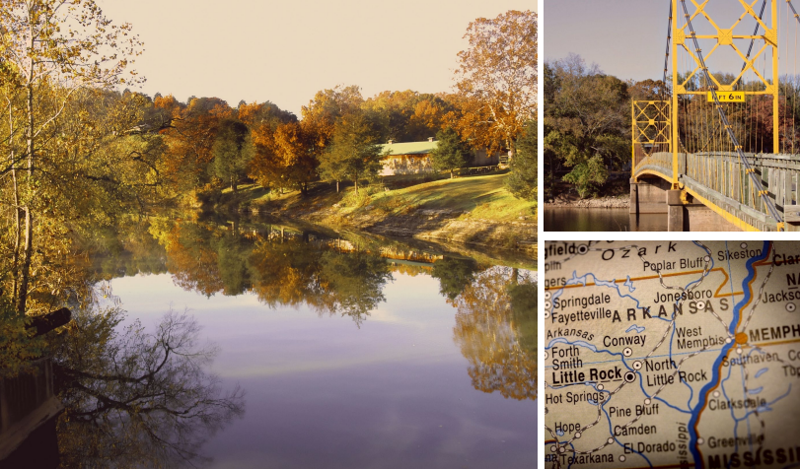
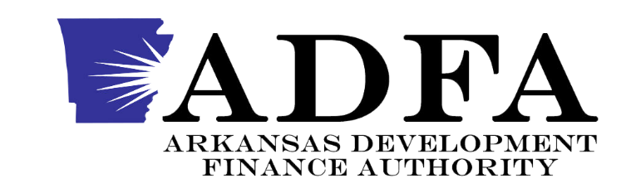
Community Development Block Grant Disaster Recovery Funding
Notes:
Andrea start

Slide 2
Introductions
Lori Brockway, ADFA, Federal Housing Programs Manager - Introductions
Andrea Gazley, ICF & Leslie Leager, ICF - Presentation

Slide 3
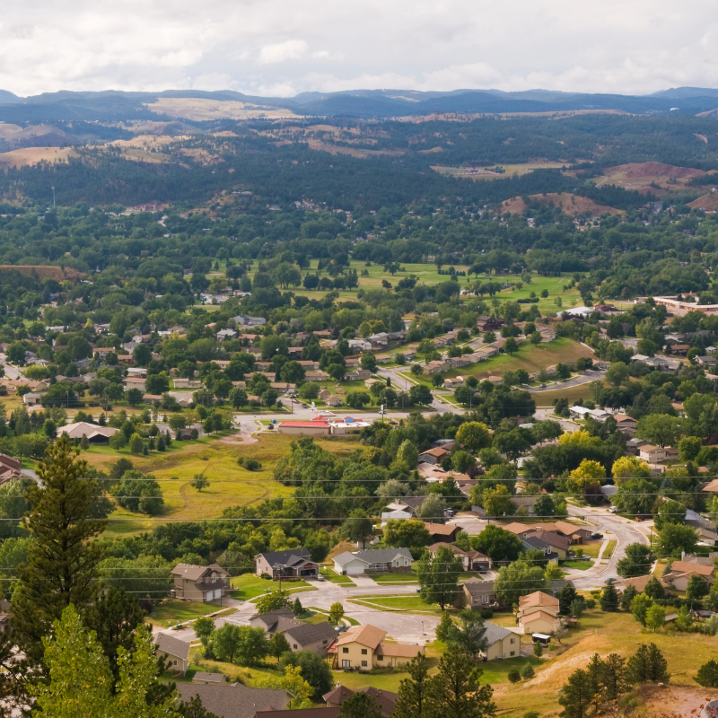
Disaster Overview
In 2023 & 2024, tornados and severe storms resulted in a major disaster declarations, which qualified the state of Arkansas to receive long-term disaster recovery funding
In December 2024, Congress appropriated $12 billion in Community Development Block Grant Disaster Recovery (CDBG-DR) for the 2024 disaster
In January 2025, the U.S. Department of Housing and Urban Development (HUD) allocated funds for states and communities that experienced disasters in 2023 and 2024. Arkansas received $59,048,000.
CDBG-DR funds will aid Arkansas in recovery from the devastating tornados and severe storms of 2023 (DR 4698) and 2024 (DR 4788) and strengthen impacted communities to help mitigate impacts in future disasters.
$59,048,000 CDBG-DR Funds Allocated to Arkansas
Notes:
In 2023 and 2024, Arkansas experienced major disasters due to tornados and severe storms, leading to disaster declarations.
In December 2024, Congress appropriated $12 billion in Community Development Block Grant Disaster Recovery (CDBG-DR) funds for the 2024 disaster.
In January 2025, the U.S. Department of Housing and Urban Development (HUD) allocated $59,048,000 to Arkansas for recovery from the 2023 and 2024 disasters.
The CDBG-DR funds will help Arkansas recover from the devastating tornados and severe storms and strengthen impacted communities to mitigate future disaster impacts.

Slide 4
What is the Community Development Block Grant – Disaster Recovery?
CDBG-DR funds are used to help the most impacted and distressed areas recover
    Funds are used to support long-term recovery needs that aren't fully covered by insurance, other federal
programs (like FEMA), or private/non-profit assistance.
CDBG-DR is a flexible source of recovery funding that can be used for infrastructure, housing, economic revitalization, and other areas where there is still an unmet recovery need.
The Arkansas Development Finance Authority (ADFA) is the lead agency (grantee) responsible for managing these funds.
Grantees have 6 years to expend all CDBG-DR funds.
Disaster
Congress
HUD
ADFA
Local Recovery
Tornados and severe storms in 2023/2024 result in disaster declaration
Passes appropriation providing disaster recovery funding
Allocates funds and sets rules for how they must be used
Leads Arkansas’ recovery planning and program design
Funds support recovery programs and are carried out at the local level

Slide 5








CDBG-DR Initial Timeline
Federal Register Notice published allocating CDBG- DR funds to Arkansas
January 15, 2025
ADFA develops unmet needs assessment, conducts stakeholder engagement, and drafts Action Plan
May-September 2025
ADFA to execute grant agreement with HUD to gain access to CDBG- DR funds
*December 2025
ADFA to submit final CDBG-DR Action Plan to HUD
*October 2025
April 2, 2023
Presidentially- Approved Major Disaster Declaration (DR-4698)
May 30, 2024
Presidentially- Approved Major Disaster Declaration (DR-4788)
March 19, 2025
HUD releases revisions to the Universal Notice, which detail grant requirements for CDBG-DR grantees, including Arkansas
*September - October 2025 ADFA to release draft CDBG-DR
Action Plan for 30- day public comment period
*October-December 2025
HUD 45-day timeline for CDBG-DR Action Plan Review
*Anticipated Date Ranges

Slide 6

Action Plan Process
To receive CDBG-DR funds, the state must complete several tasks prior to executing a grant agreement with HUD. This includes conducting an Unmet and Mitigation Needs Assessment, developing an Action Plan that identifies how the state will utilize CDBG-DR funds to address unmet disaster recovery and mitigation needs.
Unmet Needs Analysis
Mitigation Needs Assessment
Design Programs and Set Budgets

Slide 7









1
2
3
Start Action Plan
Identify Key Stakeholders
Collect Data and Draft
Assessments
Infrastructure & PA match
Federal, state & local damage
assessments
Housing damages
Public services needs
Economic impacts
FEMA & SBA data sharing
LMI areas & pre-disaster data
Mitigation needs
County, local, and state officials
State agency partners
Community partners
Federal partners
Economic development organizations
6
5
4
Action Plan Process
Consult with stakeholders:
Local staff - consider
capacity
Elected officials
Stakeholders
(identified in Step 2)
Establish Program
Priorities
Housing
Economic revitalization
Infrastructure
Public/social services
Planning
Validate Remaining Unmet Needs
Engage community on remaining unmet needs (surveys, public input events)
Compare community collected data to FEMA & SBA data
Consider programs already
available through other sources
9
Finalize and submit Action Plan to HUD
7
8
Draft Action Plan
Establish program budgets
Timelines and milestones
Project formulation
Method of distribution
Engage Community on
Proposed Programs
Post draft action plan for public access
Respond to all feedback
Incorporate feedback into final action plan
Notes:
Andrea end

Slide 8



Tie-Back to Disaster or Mitigate Future Disasters
National Objective
Categorized as Eligible Activity
Overall activities must address either:
A direct or indirect impact of the qualifying disaster, or
Mitigate threats from future disasters. Only 15% of the funds can be spent on mitigation activities
All activities must meet a national objective either:
Benefit to low-to-moderate (LMI) individuals, households and/or areas, or
Meet an urgent need
  Existing conditions related to the disaster that would impose an immediate threat to the health and safety of the community
Eligible activities typically fall into these main categories:
Housing
Economic Revitalization
Infrastructure/ Public Facilities
Public/ Social Services
Mitigation
Planning
Administration

Slide 9
MIDs and LMI Spending Requirements
MID Requirements
HUD designates the most impacted and distressed (MID) areas in the Federal Register
CDBG-DR funds must be spent to
benefit the HUD MID area.
The designated HUD MID areas for Arkansas are Benton, Cross, and Pulaski County (excluding Little Rock).
LMI Requirements
Low- to Moderate-Income (LMI) are households that earn 80% or below of the area median income.​
70% of total grant funds must​ benefit LMI households or areas.​

Slide 10
2024 LMI Income Chart of MID Counties
Households must earn 80% or below of the area median income to be LMI:
County | 1 Person | 2 Person | 3 Person | 4 Person | 5 Person | 6 Person | 7 Person | 8 Person
Benton | $57,050 | $65,200 | $73,350 | $81,450 | $88,000 | $94,500 | $101,000 | $107,550
Cross | $44,700 | $51,050 | $57,450 | $63,800 | $68,950 | $74,050 | $79,150 | $84,250
Pulaski | $59,300 | $67,800 | $76,250 | $84,700 | $91,500 | $98,250 | $105,000 | $111,800
70% of total grant funds must benefit LMI households or areas.

Slide 11
Spending Requirements
HUD sets rules for how much funding can go toward certain activities. ADFA must follow these rules to stay in compliance. The table below shows the required minimums and maximums for spending—this is meant to explain the guidelines, not show the program’s budget.
Total Allocation |  | $59,048,000
Unmet Need (disaster-related) Activities |  | $ 51,346,000
Mitigation Activities |  | $ 7,702,000
Requirements and Caps | Percentage | Total
LMI Minimum Requirement | 70% | $ 39,266,920
Administration Cap (maximum) | 5% | $ 2,952,400

Slide 12
Single-Family New Construction Program
The Single-Family New Construction program will facilitate new resilient, affordable housing that will be coordinated with homebuyer assistance
Developers will apply to ADFA through a competitive application cycle for a subsidy to contribute to the construction of the units
The homes will first be offered to disaster-impacted families and targeted to low- to moderate-income (LMI) homebuyers
LMI homebuyers can receive assistance for down-payment and closing costs
The program will incentivize new construction that incorporates construction materials and methods that will mitigate impacts from future disasters.

Slide 13
Multi-Family New Construction Program
The Multi-Family New Construction Program is designed to support the development of new multifamily rental housing.
Developers will apply to ADFA through a competitive application cycle for construction of the units
The units will first be offered to disaster-impacted families
All rental units funded through this program must remain affordable for a minimum of 20 years.
At least 51% of the units in each project must be rented to low- to moderate-income (LMI) households at affordable rental rates.
Projects consisting of more than five units will be required to include broadband infrastructure as part of the development.
The program will incentivize new construction that incorporates construction materials and methods that will mitigate impacts from future disasters.

Slide 14
Non-Federal FEMA Match – PA and HMGP
The Non-Federal FEMA Match Program will fund the non-federal cost share for State and local facilities eligible under FEMA’s Public Assistance (PA) and Hazard Mitigation Grant Program (HMGP) program
Program designed to help offset the burden of the cost share requirements
ADFA will prioritize projects that provide benefits to residential areas that benefit low- to moderate-income (LMI) households.
Funded projects must be an CDBG-DR eligible activity
ADFA will work closely with the Arkansas Division of Emergency Management (ADEM) in the administration of this program.
ADEM will evaluate project eligibility, determining the eligible costs for matching funds, and overseeing project implementation.

Slide 15
CDBG-DR Roles and Responsibilities
Grantee
Design and implement recovery
programs to address unmet needs
Establishes internal controls to ensure performance and compliance – monitors subrecipients
Provides technical assistance to local
government partners
Reviews applications to ensure activities are eligible
Monitors projects to ensures compliance with all funding requirements
Tracks progress
HUD
Review CDBG-DR action plans and
obligate funds
Provide grantees with guidance and
technical assistance
Conducts monitoring and oversight to ensure performance and compliance
Local or State Agency Subrecipients
Beneficiaries
A business owner, renter, developer, or homeowner
Adhere to the policies that govern the award
Understand false claims or statements are subject to civil or criminal penalties
Partner to the grantee in program implementation
Subject to all applicable administrative, financial and cross- cutting Federal rules and requirements
Comply with the terms and conditions of a Subrecipient Agreement
Meet performance goals
Be cooperative to any monitoring

Slide 16
Ineligible uses of CDBG-DR funds
All CDBG-DR funded activities must be an eligible activity, meet a national objective, and show a tieback to the disaster or be an eligible mitigation activity.
There are additional restrictions on the types of activities that can be funded with CDBG-DR. The following activities are not allowed:
                Equipment purchases (ex. vehicles, portable generators)
      Costs already covered by FEMA, insurance, or other federal programs ("duplication of benefits")
      General government operations (e.g., salaries not tied to disaster recovery)
      Political activities or lobbying
      Luxury or non-essential items, like decorative features or amenities
      Rehabilitation or reconstruction of second homes or vacation homes
      Maintenance and operations expenses
      Rebuilding structures in the floodplain (limitations apply)
      Supplanting funds

Slide 17
Grant Compliance Requirements
Using CDBG-DR funds comes with important rules, including:
No duplication of benefits: CDBG-DR can’t pay for costs already covered by FEMA, insurance, SBA loans, or other sources.
Environmental review is required: Before projects begin, they must follow federal environmental rules under NEPA (National Environmental Policy Act).
Strict rules for contracts and spending: Grantees and partners must follow federal procurement and financial management rules and guidelines (known as the Uniform Guidance).
Labor standards apply: For construction work, Davis-Bacon wage rules require that workers are paid fair, federally-set wages.
Fair housing and civil rights laws must be followed: Programs must be inclusive and prevent discrimination in housing and services.

Slide 18
We want to hear from you
There are several additional ways you can participate in the Action Planning Process:
Take the Unmet Needs Survey: https://app.smartsheet.com/b/form/4f0c4417193f457e8a7adfa845e737dd. It will be available until July 31, 2025. It should take less than 5 minutes to complete.
Review and Comment on the Action Plan: The Action Plan will be posted on the ADFA website by September 15, 2025. The public is encouraged to comment on the programs that ADFA will fund with CDBG-DR dollars
Attend the Action Plan Public Hearing: ADFA will hold a virtual public hearing after September 15, 2025 to receive comments on the Action Plan. Registration and the exact date will be posted on ADFA’s CDBG-DR Disaster Recovery page.
Visit ADFA’s CDBG-DR Disaster Recovery Page: Community Development Block Grant Disaster Recovery (CDBG-DR) - Arkansas Development Finance Authority (https://adfa.arkansas.gov/programs/community- development-block-grant-disaster-recovery-cdbg-dr/).

Slide 19
Thank you
For additional Information please contact:
Lori Brockway, Federal Housing Programs Manager
Arkansas Development Finance Authority
Telephone: (501) 682-3339
Email: Lori.Brockway@Arkansas.gov

